Slide 1



TELE-DOC
TELE-DOC IS A COMPREHENSIVE TELEMEDICINE PLATFORM DESIGNED TO CONNECT PATIENTS WITH LICENSED MEDICAL PROFESSIONALS THROUGH SECURE VIDEO AND MESSEGING CONSULTATIONS AT RUBY HOSPITAL.
GROUP NUMBER 22
SUPERVISOR: NKURUNGI EDISON
STUDENT NAME | REG NUMBER
NAKIRAGWA LETICIA NAKITY | 2023/ITB/DAY/1706G
LUBWAMA MARVIN ESUKA | 2023/ITB/DAY/0632
MARACTHO JOHN BOSCO | 2023/ITB/DAY/1005
KIKULE AUGUSTINE | 2023/ITB/DAY/1365
LEPI DENISH | 2023/ITB/DAY/0628
KAPERE INNOCENT | 2023/ITB/DAY/0939

Slide 2


BACKGROUND
The rapid advancement of technology has revolutionized various sectors, and healthcare is no exception. Traditional healthcare models, often characterized by physical clinic visits, are increasingly becoming less efficient and accessible. This is particularly true for individuals residing in remote areas of Kampala, those with mobility limitations, and those with busy schedules. Telemedicine, the delivery of healthcare services through telecommunication technologies, offers a promising solution to these challenges

Slide 3


Borcelle
Medical
PROBLEM STATEMENT
Long Wait Times at RUBBY hospital.
Traditional healthcare systems often involve lengthy wait times for appointments and consultations.
1999 - 2010
Development

Slide 4



SCOPE
TECHNICAL:
Enhance Accessibility: Provide healthcare services to patients regardless of their geographical location.
Reduce Wait Times: Offer immediate access to medical professionals, eliminating the need for long wait times.
Lower Healthcare Costs: Reduce costs associated with transportation, time off work, and in person consultations.
User interface: Development of a user –friendly interface for healthcare professionals to document patients encounters.
Data security: implementation of robust security measures to protect patient data, including access controls and audit trails

Slide 5

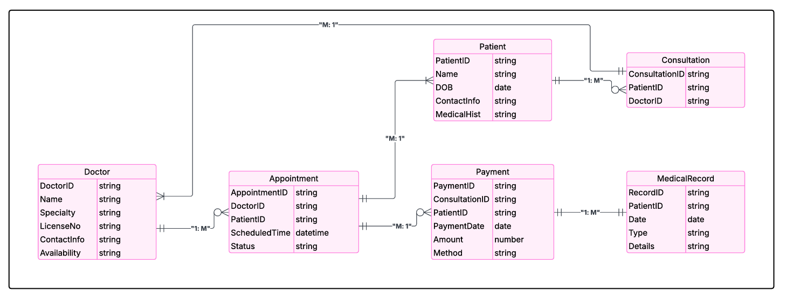
ENTITY RELATIONSHIP DIAGRAMS (ERDs)
Surgical Services
04

Slide 6
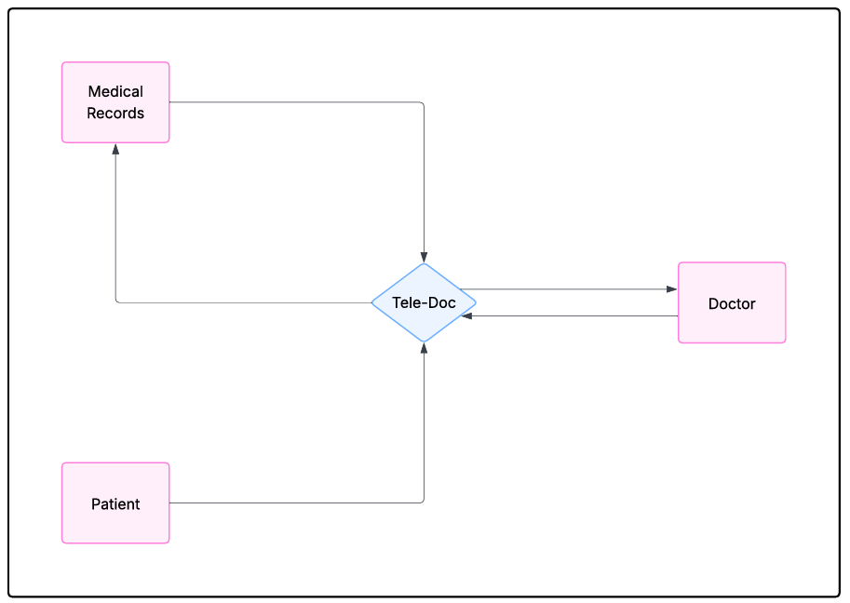
DATA FLOW DIAGRAMS (DFDs)

Slide 7
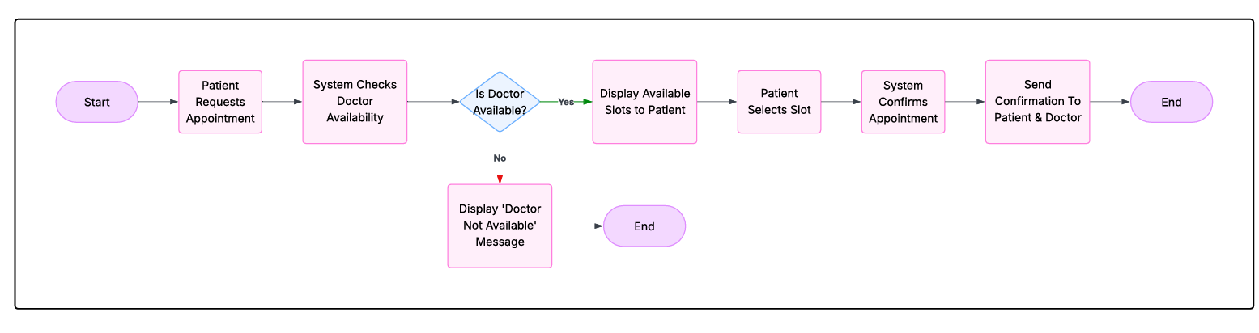
PROGRAM FLOWCHART

Slide 8
PROTOTYPE TESTING & VALIDATION
Testing Levels and key Details
PHASE | DESCRIPTION | FOCUS AREAS | TOOLS
1.Component/Unit Testing | Testing individual modules in isolation. | Login Scheduler, video call, prescription | Jest PyTest, JUnit
2.Block Testing | Testing interaction between grouped components. | Authentication Profile Appointments | Postman, Mock servers
3.System Testing | Full system tested against functional and non-functional requirements | End -to-End Workflows, Data Integrity | Selenium, postman, OWASP
4.Final system Testing | Pre-deployment testing with users and production settings | Regression, UAT, Compliance | Manual Automated tools
Outcomes
Bugs caught early (unit)
Smooth interactions(block)
Reliability &Performance (system)
Deployment readiness(final)
Testing flow diagram
(Unit Testing)
(Blocking Testing)
(system Testing)
(final testing)
Isolated app testing functionality
With all features launch
inter-module full UAT & compliance
integration checks before

Slide 9

Thank
You.
For Your Attention

